Slide 1
Intro to JavaScript (JS)
Not Your parental figure’s Javascript
Mark Brown II & Natassja Linzau (TA)
Featuring Beyonce
Notes:
REMEMBER TO OPEN CONSOLE and JSBIN in the same window

Slide 2

Who IS Mark Brown II?
Front-End Developer
Department of Commerce
Commerce Data Service
Lover of NodeJS
Practitioner of Crossfit
Student of Higher-Education Policy
Worshipper of Beyonce
Notes:
Photo Credit: http://www.hercampus.com/sites/default/files/2015/07/23/p18srdu43i1nfib54t5eqv61pet4.jpg

Slide 3
Commerce Data Academy
A data education initiative of the Commerce Data Service (CDS).
• Launched by the CDS to offer data science, data engineering, and web development training to employees of the U.S. Department of Commerce.
• Course schedule and materials (e.g. slides, code, papers) produced for the Commerce Data Academy can be found on our website at http://dataacademy.commerce.gov .
• Questions? Feel free to write us at Data Academy (dataacademy@doc.gov)

Slide 4
Course Files
Today’s code can be found at:
https://github.com/maabrown/JS_Class_Sept_2016

Slide 5
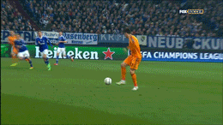
GOALS
Understand Front-End vs. Back-End
Learn JS data types
Recognize Arrays vs. Objects
Implement Looping
Write Functions
Notes:
Credit: https://giphy.com/gifs/foxsports-football-soccer-futbol-Qw4X3FCYb9sflH9HgBO

Slide 6
Front End vs Back End
What is Front-End Engineering?
Development of client / browser code
Languages: HTML, CSS, JavaScript
Typically what the user sees and interacts with
What is Back-End Engineering?
Development of server-side code
Handles things like routing, data handling and databases
Languages: Ruby, Python, Java, NodeJS, Express
Stuff "behind the scenes" that makes web applications work
Notes:
House analogy: Drywall is HTML, Paint inside is CSS, JS is the door handles, windows --- plumbing and electrical are server-side backend code

Slide 7
History of JavaScript
Created in 10 days in May 1995 – Brendan Eich (Brave Software)
Originally called Mocha → LiveScript → JavaScript
Standardized in 1996-1997 (via ECMA)
Official Release ECMA-262: ECMAScript → ES
Mostly used in web browsers
Web engines: V8 (Chrome, Opera), Nitro (Safari), SpiderMonkey (Firefox), JScript 9.0 (IE)
Notes:
Move to JS was done as a marketing move since Java (another programming language – used to build Gmail and Blue Ray Discs)
ECMA – European Computer Manufactures Association
ES5 runs in the current browsers
ES6 needs a compiler (Babel)
Credit: https://www.w3.org/community/webed/wiki/A_Short_History_of_JavaScript
Credit: http://stackoverflow.com/questions/912479/what-is-the-difference-between-javascript-and-ecmascript

Slide 8
TO BE CLEAR
JavaScript = JS
ES is a standard
JS is an implementation of ES
Versions of JS are sometimes called ES + version number
ES5 (current)
ES6 (latest)
Notes:
There are other implementations of ES such as ActionScript and JScript

Slide 9

LETS GET TO IT!
Notes:
Credit: https://giphy.com/gifs/beyonce-moments-dial-I8XaJ6ZEFHI3u

Slide 10
Informative Conversation Statements
THERE ARE NO STUPID QUESTIONS!
ASK QUESTIONS OFTEN!
PLEASE CODE-ALONG WITH ME!
I ❤️ QUESTIONS!

Slide 11
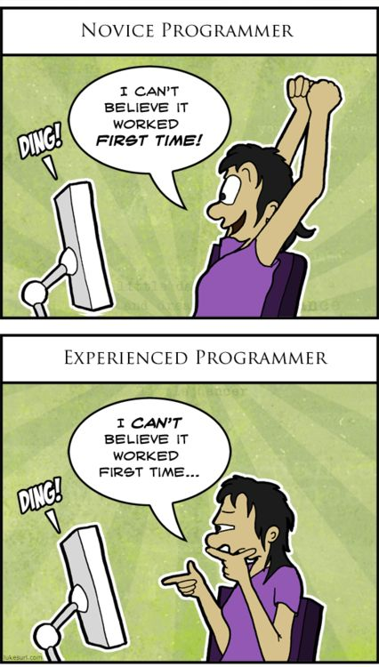
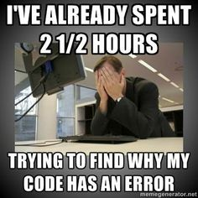
Our Agreement (Repeat After Me)
I am going to make mistakes.
I am going to get things wrong.
I am going to fail.
This is okay!

Slide 12

Getting Started
Download code from repo
Open folder (directory) in Code editor
Find folder on your machine using ‘Finder’ (Mac) or ‘Windows Explorer’ (PC)
MAC
Drag icon of ’index.html’ file to your web browser icon
PC
Double-click index.html (or index)
Notes:
DO SCREENSHOT OF WHAT I’M DOING
Windows Explorer is the icon

Slide 13
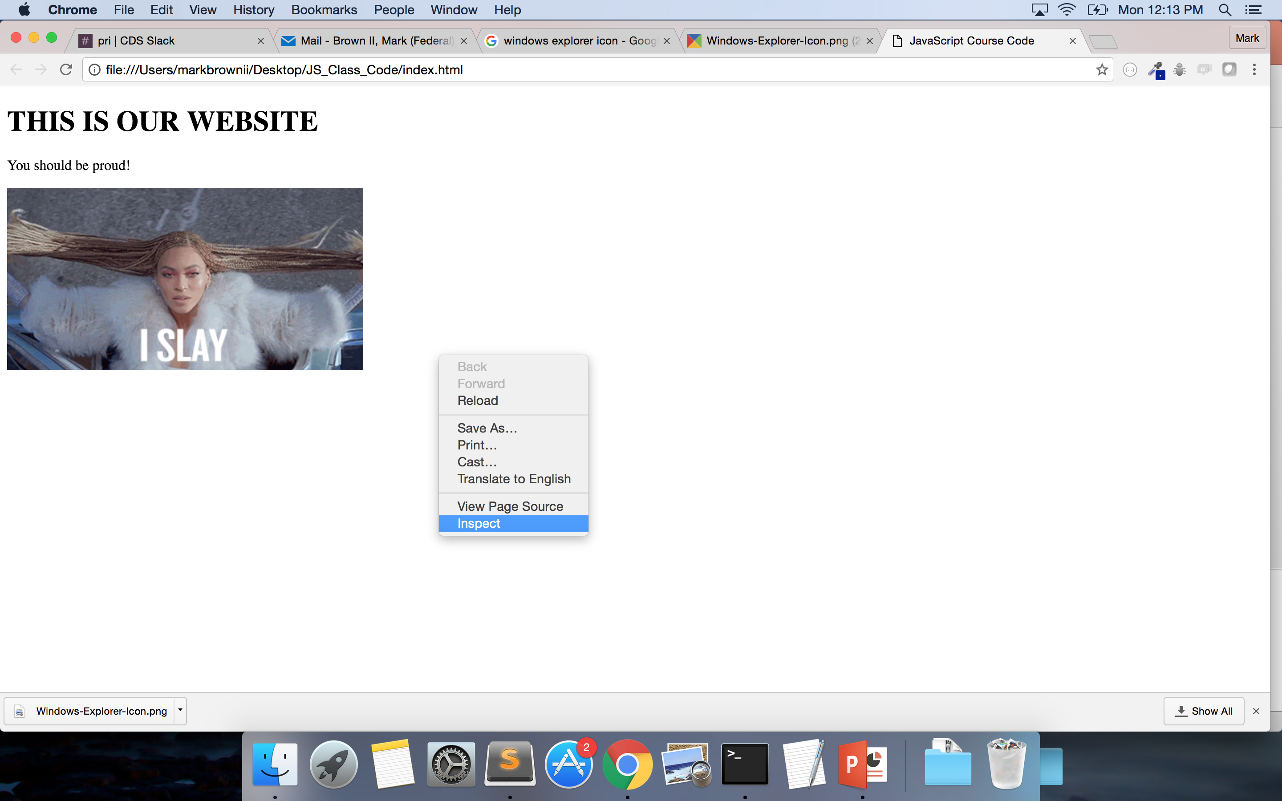
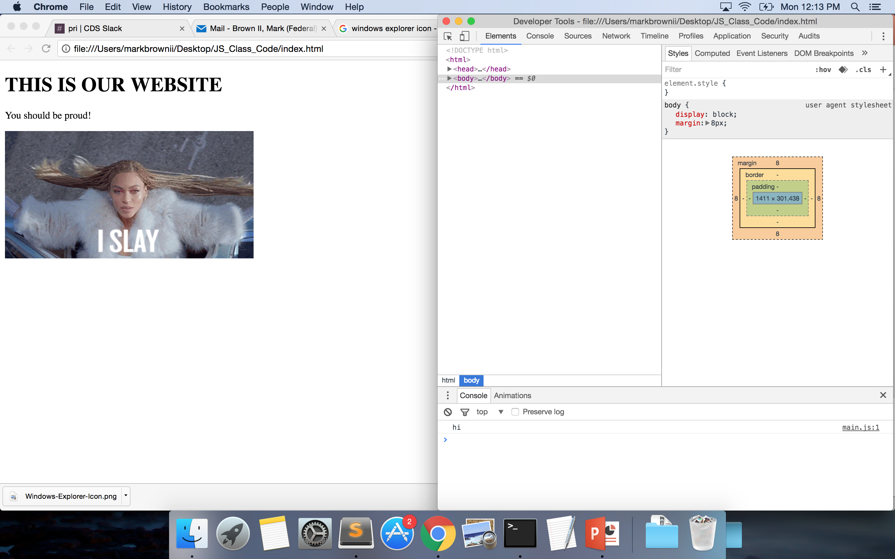
Developer Tools (on Chrome)
2 Options
Use ‘Developer Tools’ – Right click page – Select Inspect
Use JSBin.com (on next slides)
Notes:
Firefox – Inspector
Opera – Dragonfly
We won’t be working with the HTML and CSS today so feel free to make your console bigger.

Slide 14
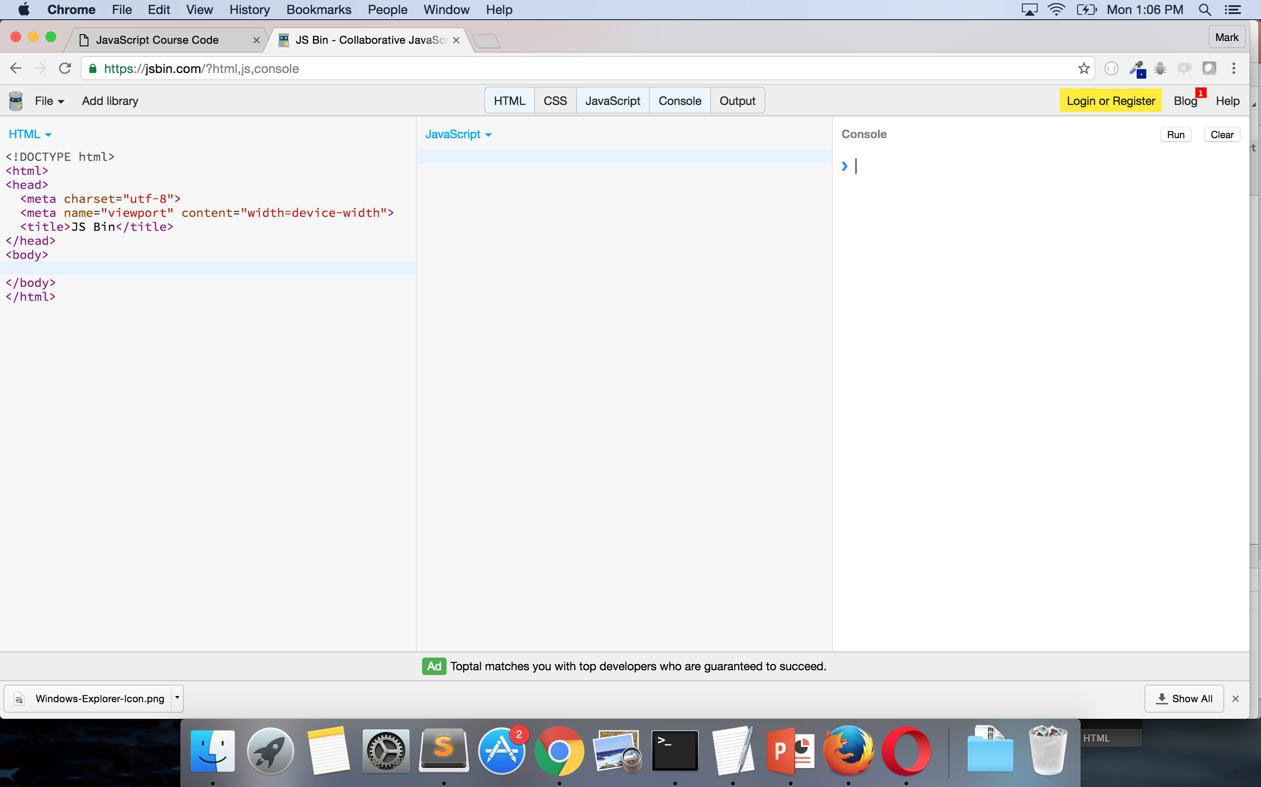
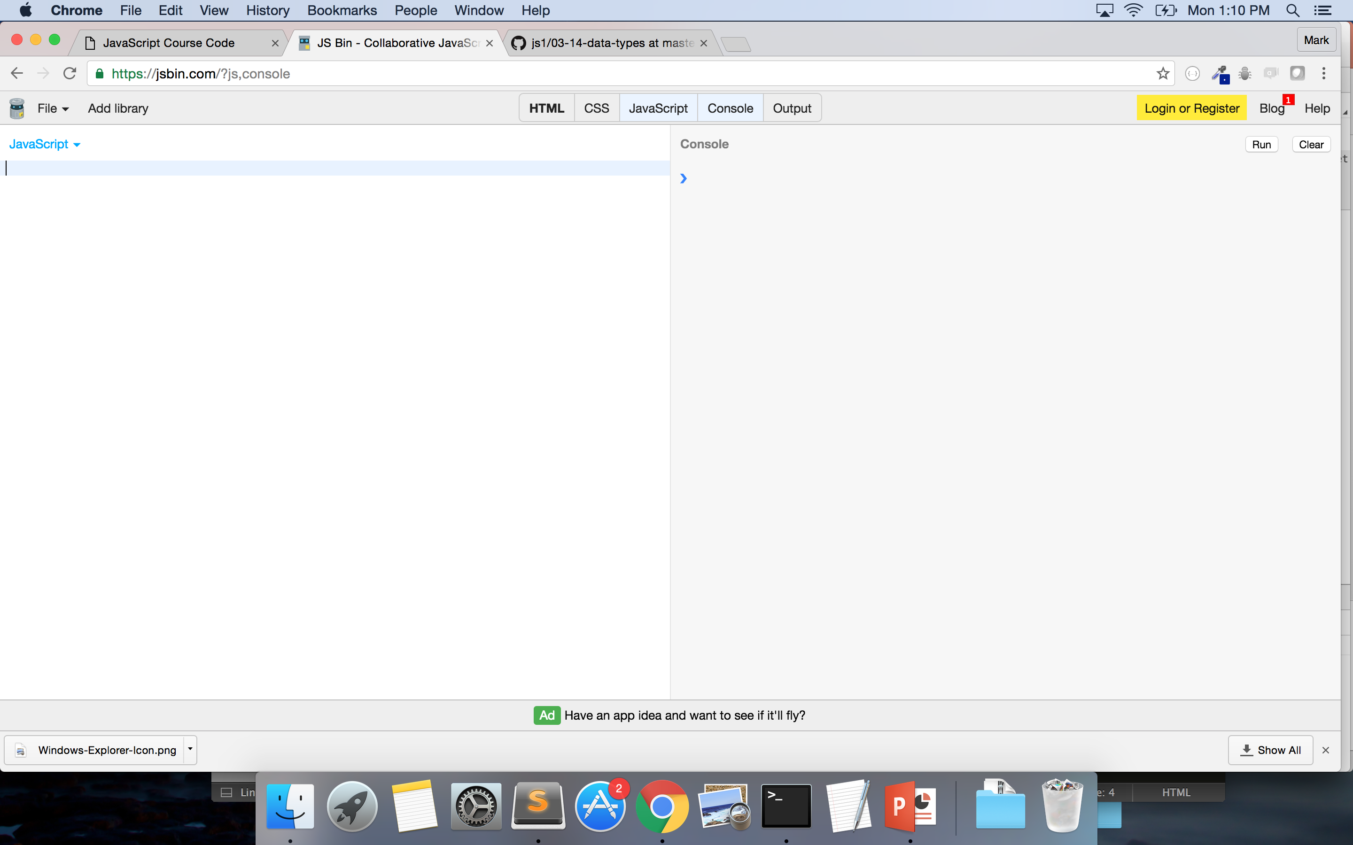
JSBin.com
Go to JSBin.com
Select ‘JavaScript’
Select ‘Console’
Unselect ‘Output’
Unselect ‘HTML’

Slide 15
Data Types
What is a data type?
It is a classification identifying one of various types of data
7 Types of Data:
String
Number
Boolean
Array
Object
Null
Undefined
Notes:
Credit: https://en.wikipedia.org/wiki/Data_type

Slide 16
STRINGS
Textual data
MUST Surrounded by double and single quotes
Consists of characters – which are zero-indexed (which includes spaces)
Spaces are characters in Strings
Examples:
”Hello”
“5”
“{ key: value }”
“kittens”
Notes:
Spaces are characters in strings – space between curly brace and k in key is a character
H’s index is 0
What is e in ‘kittens’?

Slide 17
NUMBERS - INTEGERS
Whole numbers – no decimals
Does not have a delimiter (a character that is used as a boundary in a data stream) – e.g. “,”
NaN is a number
Examples:
42
-3
10000000000000000
Notes:
Credit: https://en.wikipedia.org/wiki/Delimiter

Slide 18
NUMBERS - FLOATS
Numbers with decimals
No delimiter
Examples:
4.5
-1.333333333
5968332244.33324
3.141592

Slide 19
BOOLEAN – NULL - UNDEFINED
Boolean
Values of ‘true’ or ‘false’
Undefined
Variable without a value
Null
Essentially something that doesn’t exist
Notes:
Credit: http://www.w3schools.com/js/js_datatypes.asp
We will discuss

Slide 20
ARRAY
Ordered collection of data
Separate each value using a “,”
Can have mixed data types
Delimiters typically used:
[] – to open and close an array
, - to separate items within an array
Examples:
[3, 2, “hello”, {}, 4.555555, true] ← One array
[“hello”], [37, 91] ← Two arrays
[ [3,2,”hello”], 45, “laugh”] ← One array but an array within an array

Slide 21
OBJECT
Unordered collection of data
Can have mixed data types
Key-value pairs
Delimiters used:
{} – used to open and close objects
: - used to separate key from value
, - used to separate different objects and key-value pairs in objects
Examples:
{name: ”Beyonce”, num_of_awards: 195}
{albums: [‘Bday’, ’Dangerously in Love’, ‘Lemonade’]}

Slide 22
REPEAT AFTER ME!
ALL ARRAYS ARE OBJECTS
ALL OBJECTS ARE NOT ARRAYS
Notes:
Only way to check for type with an array is to use Array.isArray() -- https://developer.mozilla.org/en-US/docs/Web/JavaScript/Reference/Global_Objects/Array/isArray
Array.isArray([3,4,]) ➔ ‘true’
http://stackoverflow.com/questions/5048371/are-javascript-arrays-primitives-strings-objects
Really arrays are objects – but rather than having { 0: value, 1: value}

Slide 23
OPERATORS
Know most from math
+
Add numbers, concatenates Strings
-
Subtracts numbers
/
Divides numbers
*
Multiplies numbers
%
Returns the remainder from the division
Notes:
Go to jsbin or console and show examples
Make sure to do string subtraction
Returns NaN because of JS coercion!
When JS sees that math is being done, tries to convert the strings to numbers – which they aren’t – and thus gives NaN
Another example: console.log(5 + “3”) returns “53” – JS converts 5 to a string and then concatenates since 3 was a string

Slide 24
Introduction to console.log & typeof
Console.log()
Is a function
Returns the value computed to the console
typeof
Is an operator
Tells you the data type of an input

Slide 25
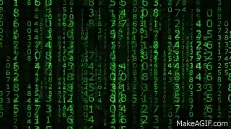
CODE-ALONG!
Notes:
ALWAYS END STATEMENT WITH SEMICOLON!
Console.log(“Mark”);
Console.log(65);
Console.log([4,7,10]);
Console.log(Mark); → so they see that it gets ‘undefined’
Console.log(typeof Mark);
Console.log(typeof 65);
Console.log([4,7,10]);
Console.log({ ’key’ : ’value });
Console.log(3+5);
Console.log(7*10);
Console.log(9 % 5); → 4 -- Think of it as 9 % 5 with a remainder of 6
-- can be used to see if a number is even or multiple of particular number
-- Console.log(any-number % 2) = 0 is event
-- Console.log(any-number % 3) = 0 is multiple of three
Credit: https://giphy.com/gifs/gh-C6UVM5TbW1Y2s

Slide 26

YOUR TURN!
Using JSBin or the Console do the following:
Use console.log to:
Write your name
Write the name of your favorite city
Write the number of days in the week
Write any array with 3 days of the week
Write an object with the following key/value pairs:
Rose: Red, Violets: Blue, Cosmos: Purple
Use ’typeof’ to see the types of each of the above
Use console.log to:
Multiply 8 by 5
Add 10 to 6
Figure out if 198874 is a multiple of 7
Notes:
Credit: https://giphy.com/gifs/typography-GqDZqVjH4XFFC
Also use this time as a break!

Slide 27
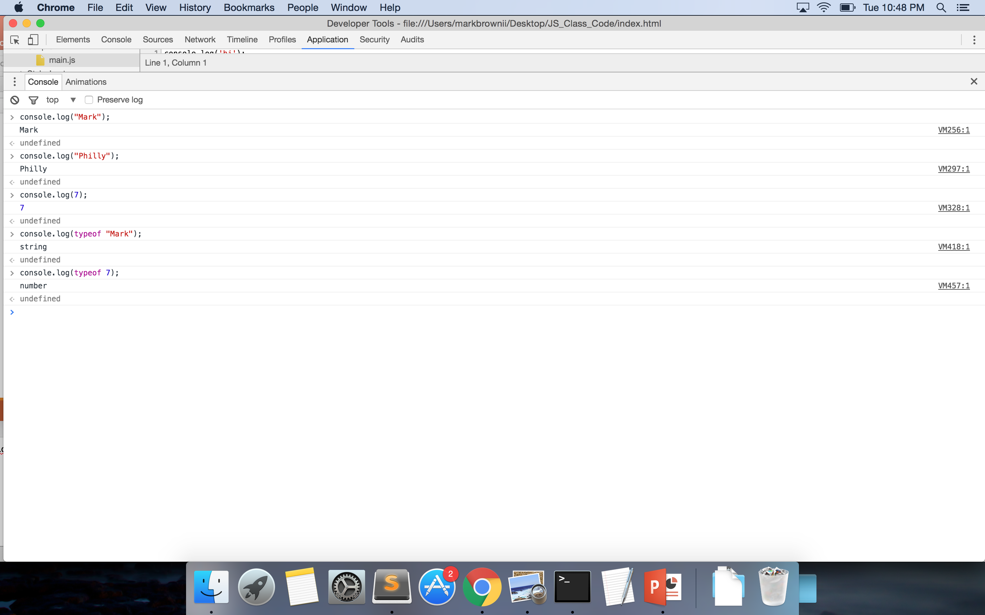
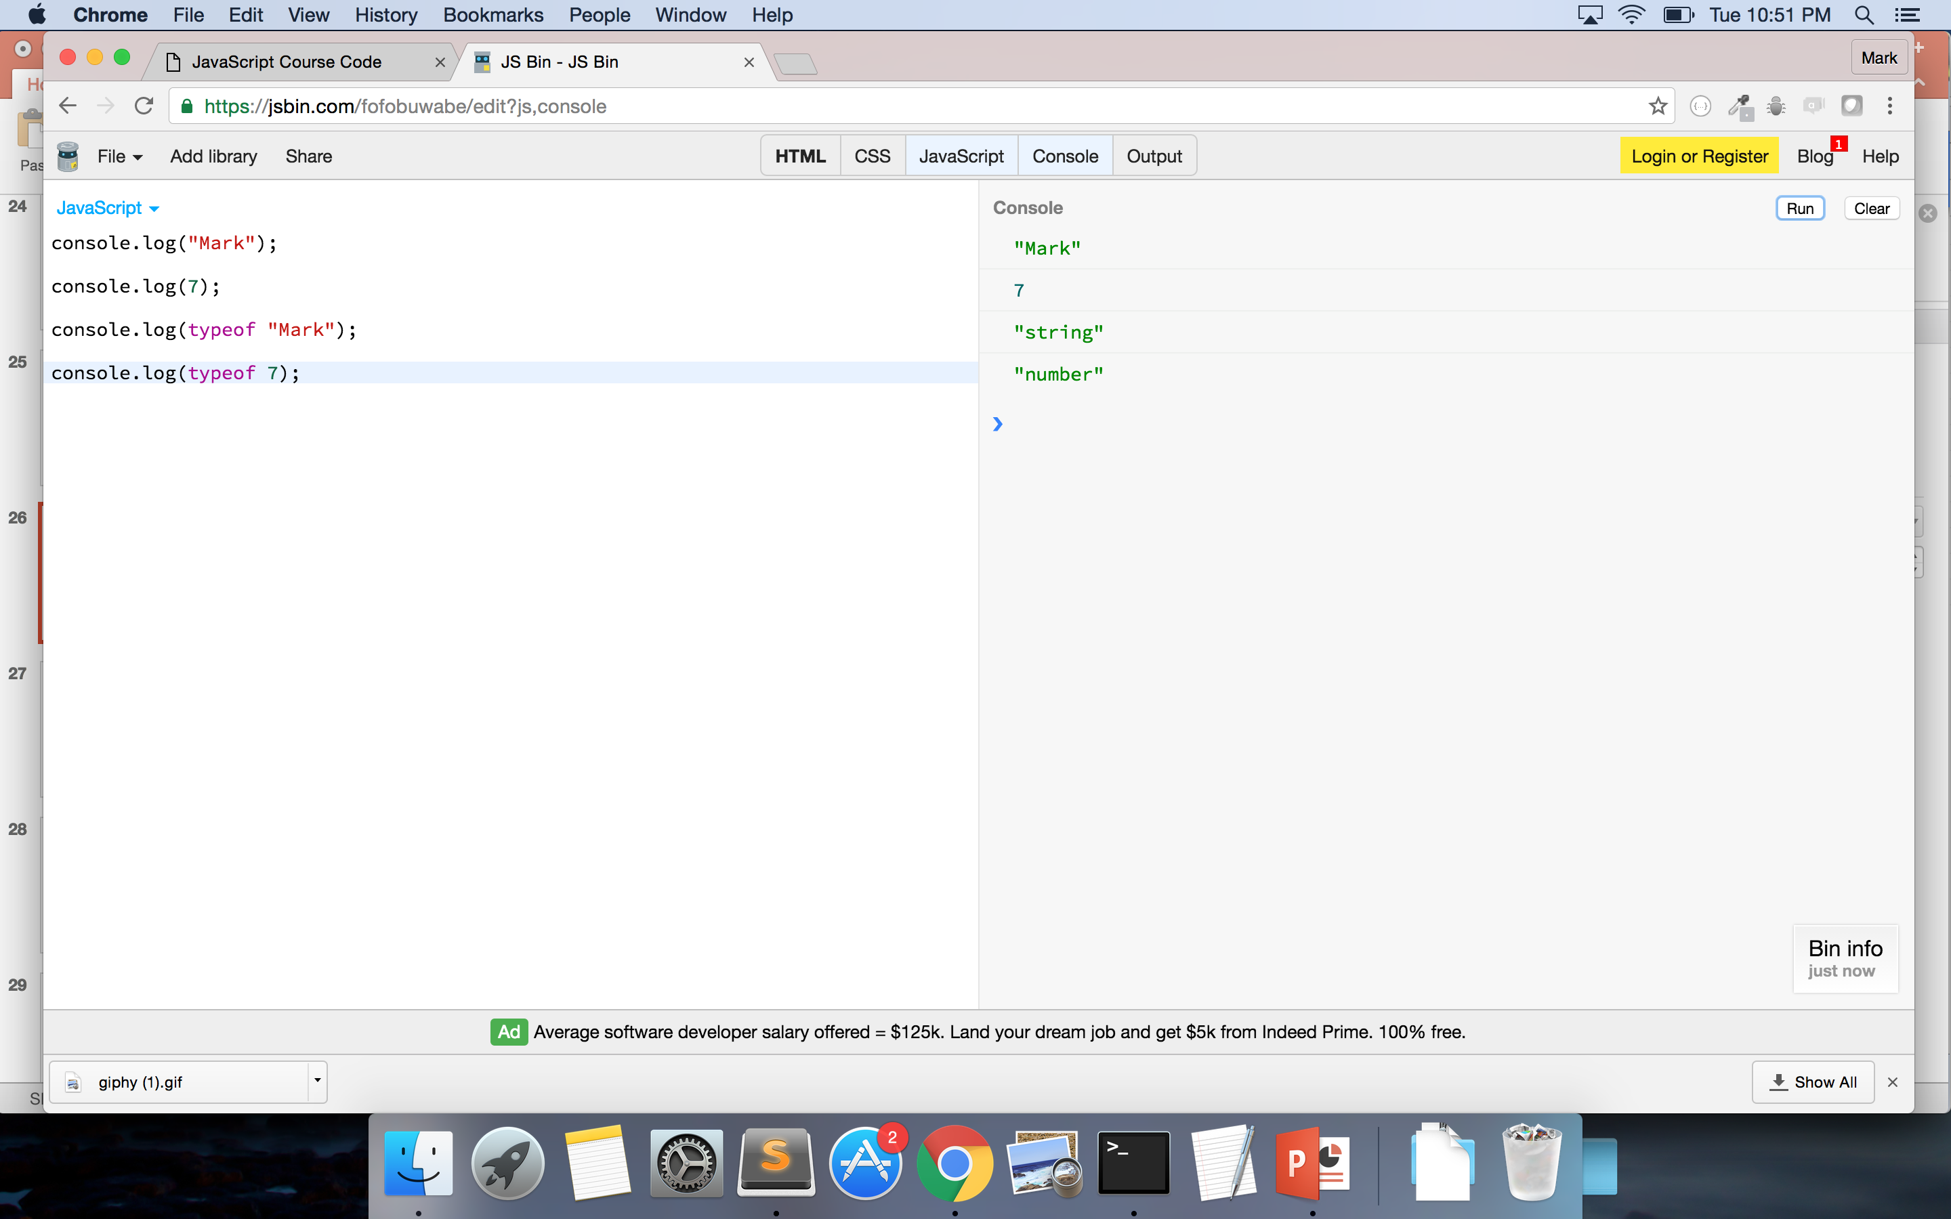
Console & JSBin

Slide 28

POP QUIZ!!
1. What is Front-End engineering?
2. Are JavaScript and ES equivalents?
3. What are the differences between Integers and Floats?
4. Is “5” the same as 5?
5. ‘True’ and ‘False’ are what type of data?
6. What are the differences between an array and an object?
7. True/False: I can have mixed data types in my array.
8. How can I check a datatype using my computer?
Notes:
Credit: https://giphy.com/gifs/m4QebXYgrWGkw

Slide 29
WHAT DO YOU MEAN BY ORDERED?
Arrays
Each piece of data has an index (order-value associated with it)
Is zero-indexed (first item has the index of 0)
Similar to Strings!
Objects
Pieces of data are not indexed
Data based on key-value pairs

Slide 30
VARIABLES
Used to store information to computer’s memory for future use
Declaring
Always use keyword ‘var’
var myName
Assigning
Always use a “;”
var myName = “Mark”;
Can assign variables any value – including arrays, objects, functions
Calling
Use variable name – not the value
Returns ‘undefined’ if variable isn’t assigned a value
Notes:
Mention camelCase or _underscore – consistency is key
Check with framework – sometimes _underscore can have implications in your code
Go to Console and do:
var a
Var a = 5;
A
If using JSBin – you must must declar and assign variable outside of console.log() – you can console.log to call the variable
If you don’t declare and assign – console.log will tell you it is not defined

Slide 31
ARRAYS (cont.)
Store data
Consists of ‘elements’
Zero-indexed (index starts at 0)
Data can be added, deleted, and changed
Elements are stored in sequential order
First position is 0, second position is 1, etc
# of elements found by (length – 1)
var names = [‘Beyonce’, ‘Bey’, ‘Yonce’];
names[0] = ‘Beyonce’
names[2] = ?
Other methods you can use with arrays:
Slice();
Reverse();
toString();
Other methods: https://developer.mozilla.org/en-US/docs/Web/JavaScript/Reference/Global_Objects/Array
Notes:
Due to index – do you understand why order is important?
Use JSBin to do:
var dsNames = [”Kelly”, “Michelle”, “Beyonce”]
Console.log(dsNames.length)
var memberName = dsNames[1]
memberName
Can use the keyword ‘new’ so var newArray = new Array(‘things’, ’to’, ’do’); - but not seen as best practice

Slide 32
CODE-ALONG!
Notes:
ALWAYS END STATEMENT WITH SEMICOLON!
var names = [‘Beyonce’, ‘Bey’, ‘Yonce’]
var newNames = names.split(0,1); → [‘Beyonce’]
var newNewNames = names.split(0,2); → [‘Beyonce’, ‘Bey’]
Credit: https://giphy.com/gifs/gh-C6UVM5TbW1Y2s

Slide 33
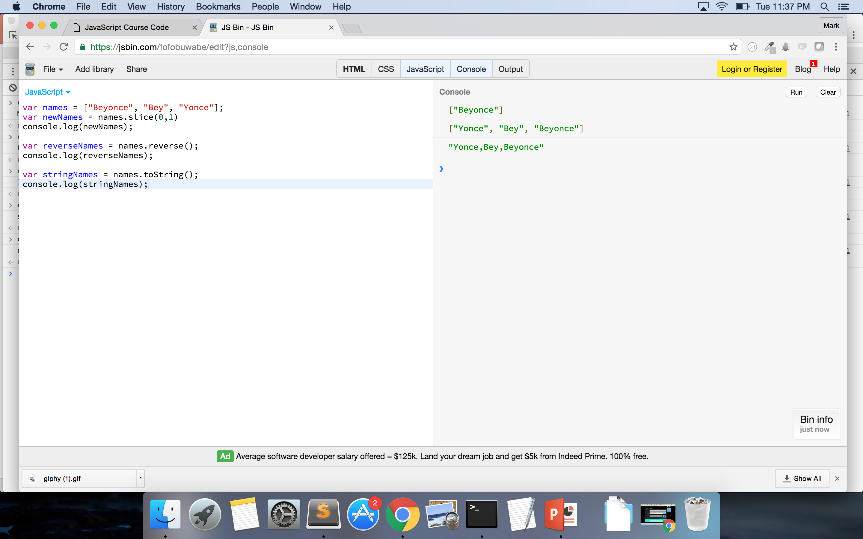

Slide 34
OBJECTS (cont.)
Store data
Consists of ‘key-value’ pairs
KEY: VALUE
Data can be added, deleted, and changed
Order does not matter - indexed by the ‘key’
var newObject = {
name: ”Mark Brown II”,
position: “ Developer”,
employer: “Department of Commerce”
}
Access values by:
objectName[key] = value
newObject[name] = ”Mark Brown II”
newObject[“position”] = ?
objectName.key = value
newObject.employer = ?
Use “ “ when key has number or other special characters
Use same notation to add key/value to object
newObject.hair = “natural”

Slide 35
PRACTICE
var practiceArray = [
“JavaScript”,
“Ruby on Rails”,
“C++”,
“AngularJS”
]
What is practiceArray[2]?
How would I get the value of ‘Java’?
How would I get the length of practiceArray?
var practiceObject = {
develop: “web”,
language: “JavaScript”,
dataType: “object”,
bureaus: [
“BEA”, “NOAA”, “NIST”, ”MBDA”
]
}
What are the keys in this object?
What is the value of practiceObject.language?
How would I get the value ‘NIST’?
Notes:
Please make sure to use the DOUBLE QUOTATION MARKS FOR JSBIN

Slide 36

BREAK!

Slide 37
JSON
JavaScript Object Notation
Data objects consisting of attribute-value pairs
Passed back from AJAX calls – calls to API (Application Program Interface)
Based on JS – can be read by many other languages

Slide 38
PROBLEM SET
Using the DoC JSON example:
1. How would I get the array of “tags” from the first object in the ”data” array?
2. How would I get the value of “label” in the second object from the “categories” array of the second object?
3. What is the value of “galleries” for the third object in the “data” array?
4. What is the data type of the value of “id”?
5. How would I get the title of the image for the “25 Years of Supporting U.S. Manufacturing” object?
Notes:
ANSWER:
data[0].tags OR data[0][“tags”]
data[1].categories[1].label OR data[1][“categories”][1][“label”]
Null
Number – Integer
data[2].image[0].title OR data[2][“image”][0][“title”]

Slide 39

QUESTIONS????

Slide 40
PSEUDOCODE!!!!
Text-based detail breakdown of what you want to do in your code
MAKE NO ASSUMPTIONS
Every detail counts!!
1. I want to alphabetize everyone’s first name in this room.
2. I gave you a list of 10 numbers, how would I put them in order?
Notes:
USE SUBLIME!!

Slide 41
PSEUDOCODE (Your turn – Pair Programming)
How would you code the following:
1. I give you a list of words. I want you to capitalize the first letter of each word.
2. I hand you a grade book with 10 grades in it. If a grade is greater than 60, print “passed” – else, print “failed”
3. I give you a box full of books and tapes, I want you put the tapes in one box and the books in another.

Slide 42
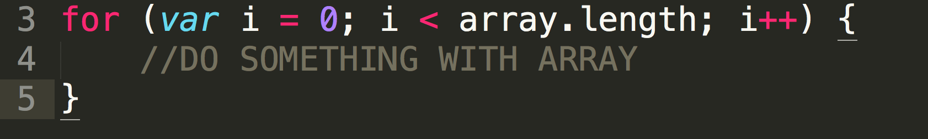
LOOPING - ARRAY
What if I wanted the “label” for every object in the “data” array?
That’s where looping kicks in!
INTRODUCING:
++ operator – Increments value by 1
-- operator – Decreases value by 1
FOR ARRAYS:

Slide 43
PRACTICE
Go to repo
Open main.js
1. Write a ‘for’ loop that logs every item in the beyonceSongs.
2. Write a ‘for’ loop that adds 2 to every item in the numberArray and pushes the new number to a new array.
Take a look at Array.push() - http://www.w3schools.com/jsref/jsref_push.asp

Slide 44
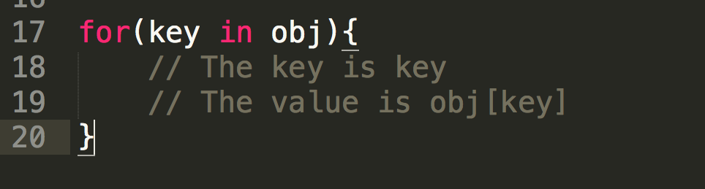
LOOPING - OBJECT

Slide 45
PRACTICE
Go to repo
Open main.js
1. Write a ‘for’ loop that logs every key in lemonadeAlbum.
2. Write a ‘for’ loop that logs every value in lemonadeAlbum.

Slide 46

BREAK!!
Notes:
Credit: https://giphy.com/gifs/beyonce-we-like-to-party-dancing-9pcASxfqgNa5G

Slide 47

Notes:
Credit: https://giphy.com/gifs/bfv-braxtons-towanda-traci-3o7TKJbg9tcu3OkF7a

Slide 48

FUNCTIONS
Resuable statement or group of statements
Can be called anywhere within the program
DRY – Don’t repeat yourself
Use keyword ‘function’
Must be defined first → Executed (usually)
Notes:
DRY - never write the same code twice
Credit: https://giphy.com/gifs/excited-family-guy-stewie-griffin-7eAvzJ0SBBzHy

Slide 49
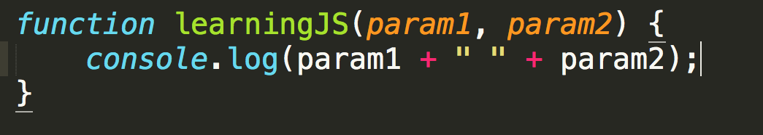
FUNCTIONS
4 Parts:
1. Keyword ‘function’
2. Name of the function (Optional)
3. Parameters (Optional)
4. Code inside the function (Optional)
Notes:
Context – I put optional by the name of the function because as you progress in JS you will find yourself potentially using anonomyous functions
And technically the code inside the function is optional because the computer will still run your function even if you tell it to do nothing but
Typically you want to name your functions and you want there to be code inside

Slide 50
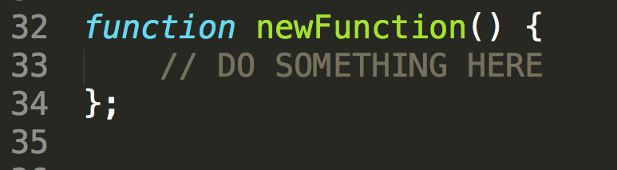
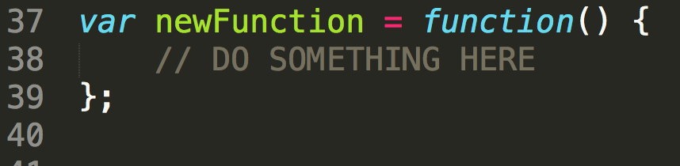
FUNCTIONS
DECLARATION
Expression
Names the function within the definition
Declares variable to name the function

Slide 51
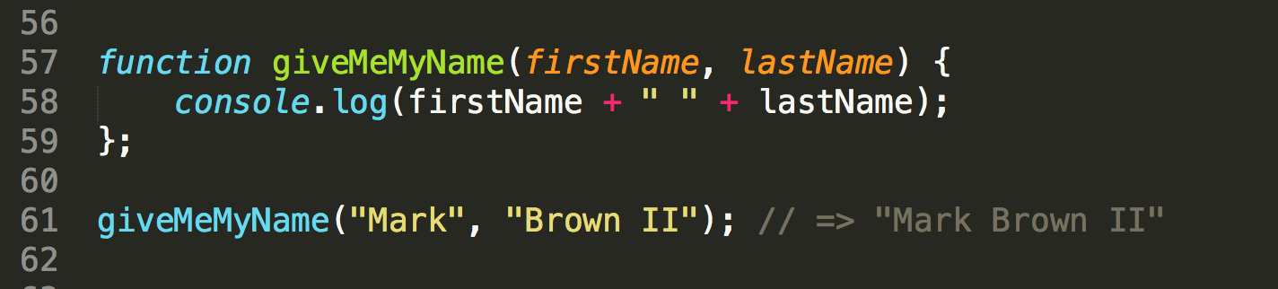
FUNCTIONS – Calling and Parameters
Write parameters in initial function definition
Pass in those values to function when calling it
Uses those values in its computation

Slide 52
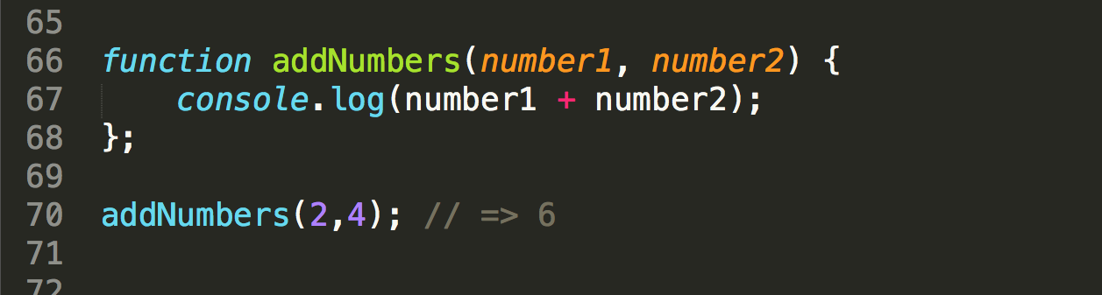
FUNCTIONS – Calling and Parameters

Slide 53
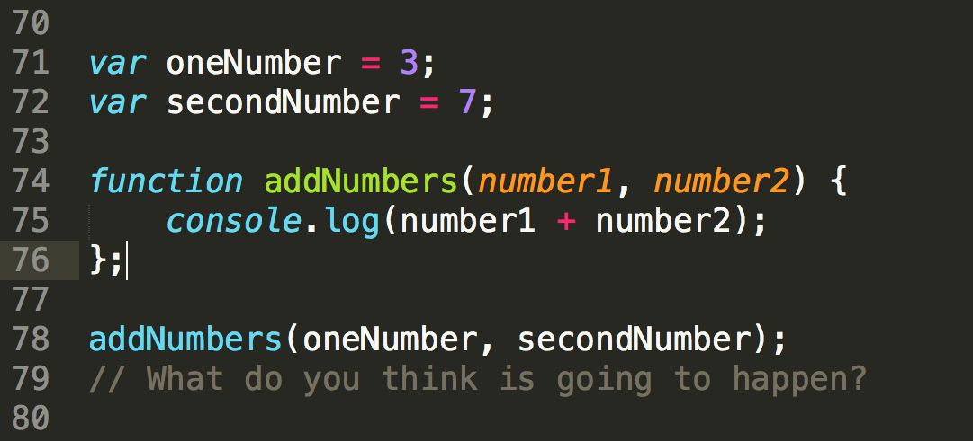
FUNCTIONS – Calling and Parameters
Notes:
Who wants to give me another way of writing this function WITHOUT using parameters?

Slide 54
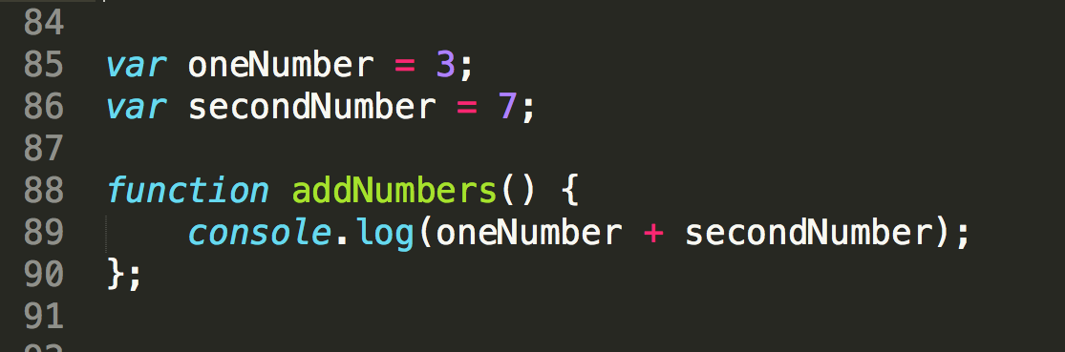
FUNCTIONS – Calling and Parameters

Slide 55
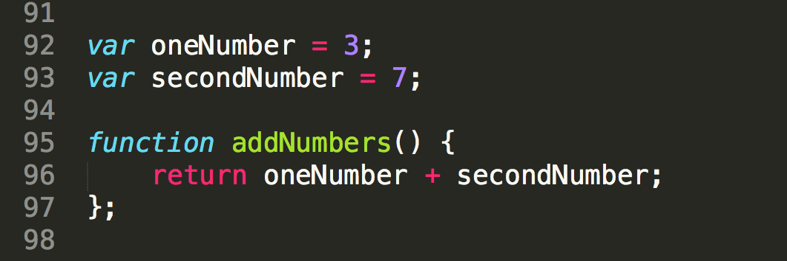
FUNCTIONS – keyword ‘return’
Returns the value of your functions computation
REMEMBER: ‘return’ stops the function’s execution

Slide 56
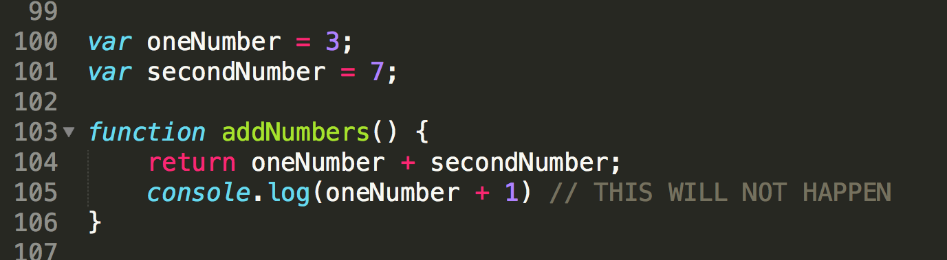
FUNCTIONS – keyword ‘return’

Slide 57
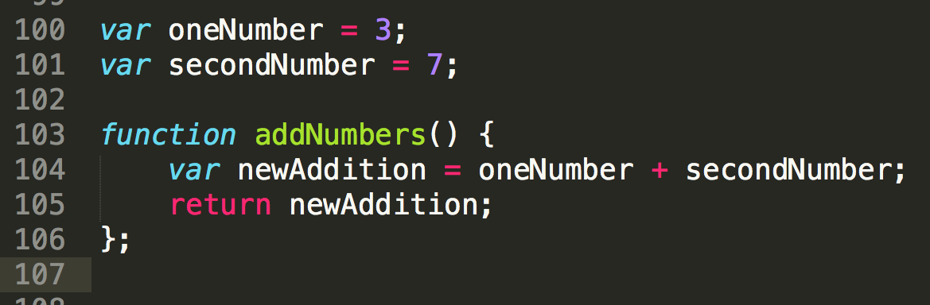
FUNCTIONS – keyword ‘return’

Slide 58
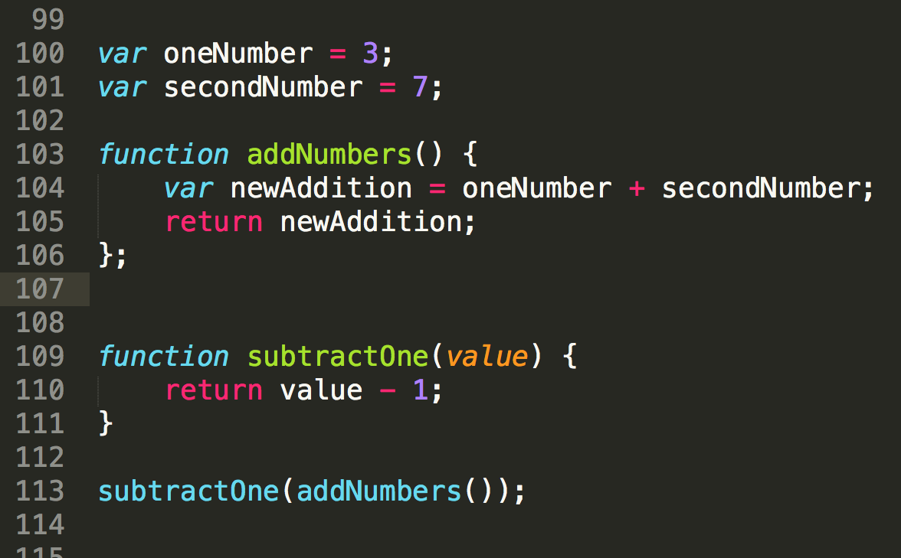
FUNCTIONS – keyword ‘return’
Notes:
Can pass functions to other functions – THIS IS WHEN IT GETS FUN
Still follows traditional math setup – evaluates what is inside first – and then works outward
WHY DO YOU THINK WE DO THIS? Allows us to not have to re-write code if something needs to be changed
Makes our code much cleaner to read

Slide 59
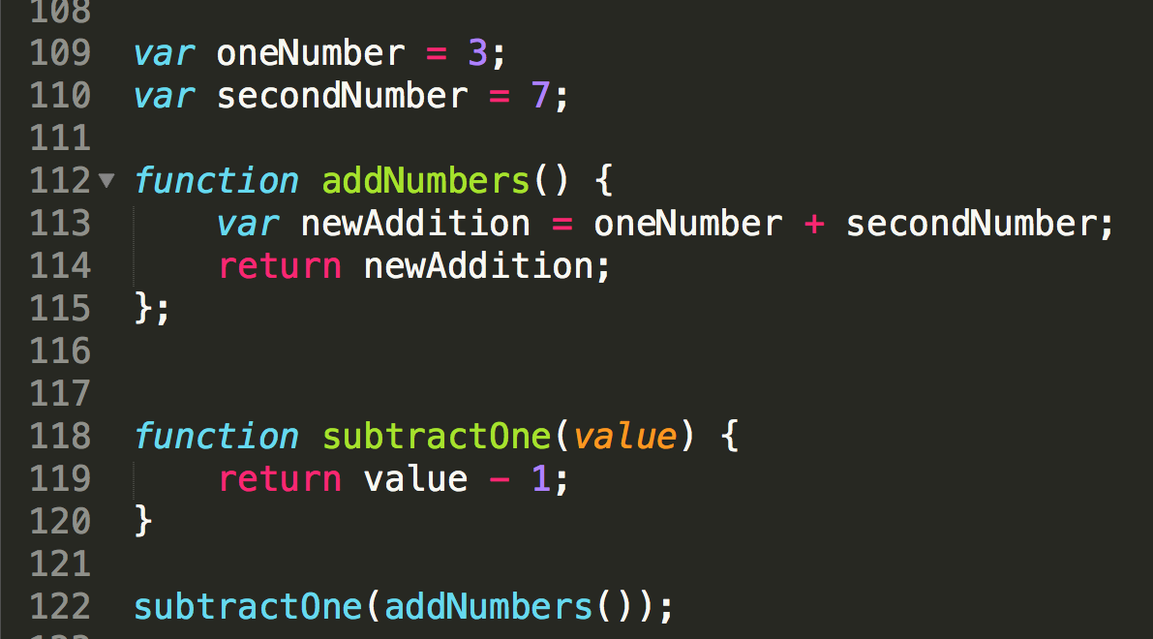
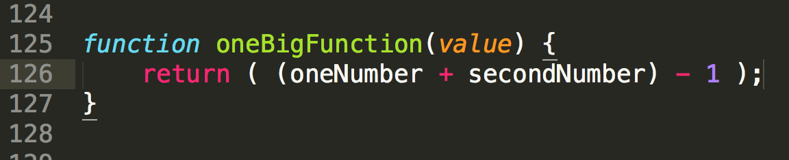
FUNCTIONS - Readability
Break down complex tasks
Readability
Lessens margin of human error
Allows for code flexibility
Allows for code reuse
Notes:
Less code doesn’t always mean better code and doesn’t make you a better developer – think about teammates and future developers
Can you reuse the second one? But couldn’t you reuse the subtractOne function somewhere else?
If someone wanted you to subtract 1 and then multiply it by 3 – imagine how the second function will look vs. updating the first

Slide 60
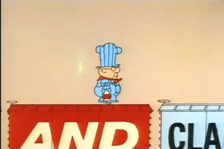
FUNCTION PRACTICE!
1. Write a function that console.log’s your name
2. Write a function that will square any number I pass into it.
3. Write a function that will take a value and add it to an array.
4. Write a function that will console.log the values of an object by looping.
5. Write a function that will add 1 to every element of an array by looping.
6. Write a function that will tell me the dataType of every element in an array.
Notes:
WRITE THE ARRAYS AND OBJECTS FOR THESE EXERCISES

Slide 61

Remember – YOU CAN DO THIS!
Notes:
Credit: https://giphy.com/gifs/beyonce-hair-flip-11wsZr0jbXc15m

Slide 62
FUNCTION PRACTICE!
1. Write a function that console.log’s your name
2. Write a function that will square any number I pass into it.
3. Write a function that will take a value and add it to an array.
4. Write a function that will console.log the values of an object by looping.
5. Write a function that will add 1 to every element of an array by looping.
6. Write a function that will tell me the dataType of every element in an array.
Notes:
WRITE THE ARRAYS AND OBJECTS FOR THESE EXERCISES

Slide 63

OMG POP QUIZ!
1. What’s the difference between a float and integer?
2. True/False: You can only get the value from an object using dot.notation. e.g. object.key = value
3. What are 2 major differences between arrays and objects?
4. What’s another name for JavaScript?
5. True/False: JSON is a group of arrays.
6. True/False: Functions must always take a parameter.
7. True/False: Less code is always better code.
Notes:
Credit: https://giphy.com/gifs/surprise-fabulous-pajamas-A5F11Cbo7b8cw

Slide 64
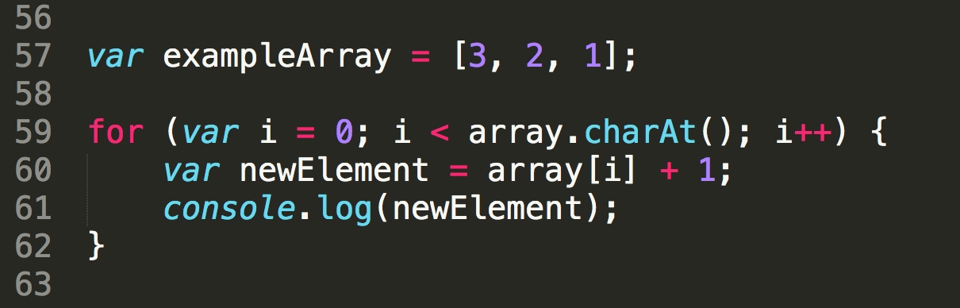
WHAT’S WRONG?
Notes:
Wrong array name
Array.length

Slide 65
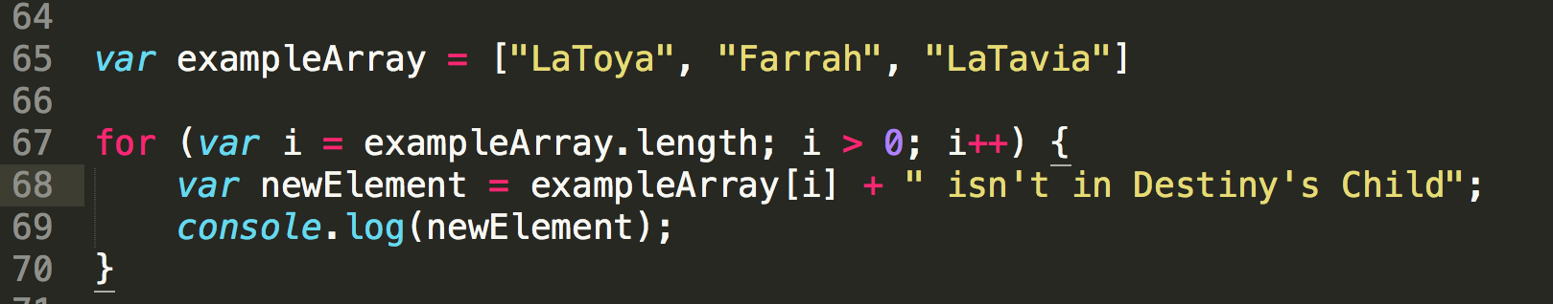
WHAT’S WRONG?

Slide 66
Resources for Continued Learning
Code School
Eloquent JavaScript
Pluralsight
Udacity

Slide 67
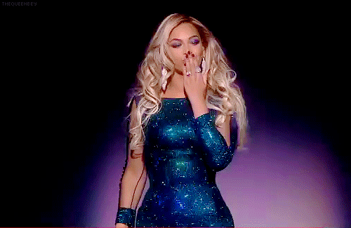
THANK YOU FOR COMING!
Hope you had as much fun as I did!!
Notes:
Credit: https://giphy.com/gifs/kim-kardashian-gif-simcity-buildit-QCevNzgfKTigg

